Slide 1
Securing Critical Infrastructure Stephen Dunlap, CISSP
Air Force Institute of Technology
stephen.dunlap.ctr@afit.edu
937-255-3636 ext. 3324
This briefing, presentation, or document is for information only.
No US Government commitment to sell, loan, lease, co-develop
or co-produce defense articles or provide defense services is implied or intended.
Notes:
UNCLASSIFIED
Intro
Image source:
https://pixabay.com/en/twitter-social-media-icon-social-2430933/
UNCLASSIFIED

Slide 2
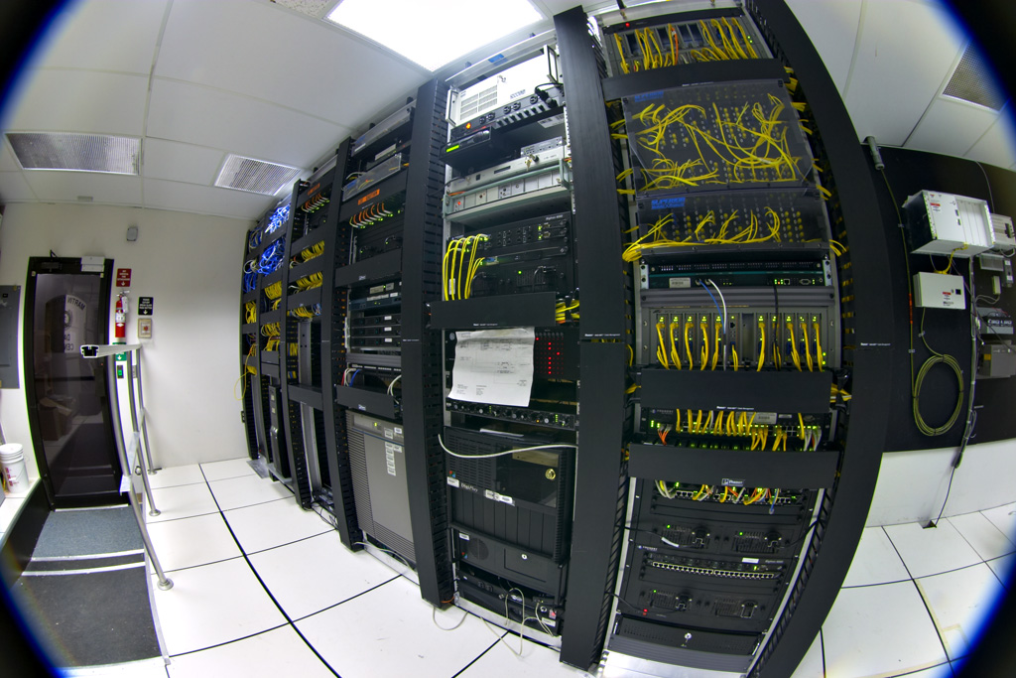
Information Technology
Source: Telecommunications equipment in one corner of a small data center. Contributed and licensed under the GFDL by the photographer, Gregory Maxwell
Notes:
UNCLASSIFIED
This is what you think of when you talk about IT systems
IT/OT convergence:
Source: http://searchitoperations.techtarget.com/definition/IT-OT-convergence
IT includes any use of computers, storage, networking devices and other physical devices, infrastructure and processes to create, process, store, secure and exchange all forms of electronic data. OT, traditionally associated with manufacturing and industrial environments, includes industrial control systems (ICS) such as supervisory control and data acquisition (SCADA).
While IT inherently covers communications as a part of its information scope, OT has not traditionally been networked technology. Many devices for monitoring or adjustment were not computerized and those with compute resources generally used closed, proprietary protocols and programmable logic controllers (PLC) rather than technologies that afford full computer control. The systems involved often relied on air gapping for security.
Increasingly, sensors and connected systems like wireless sensor and actuator networks (WSANs) are being integrated into the management of industrial environments, such as those for water treatment, electric power and factories. The integration of automation, communications and networking in industrial environments is an integral part of the growing Internet of Things (IoT). IT/OT convergence enables more direct control and more complete monitoring, with easier analysis of data from these complex systems from anywhere in the world.
UNCLASSIFIED

Slide 3
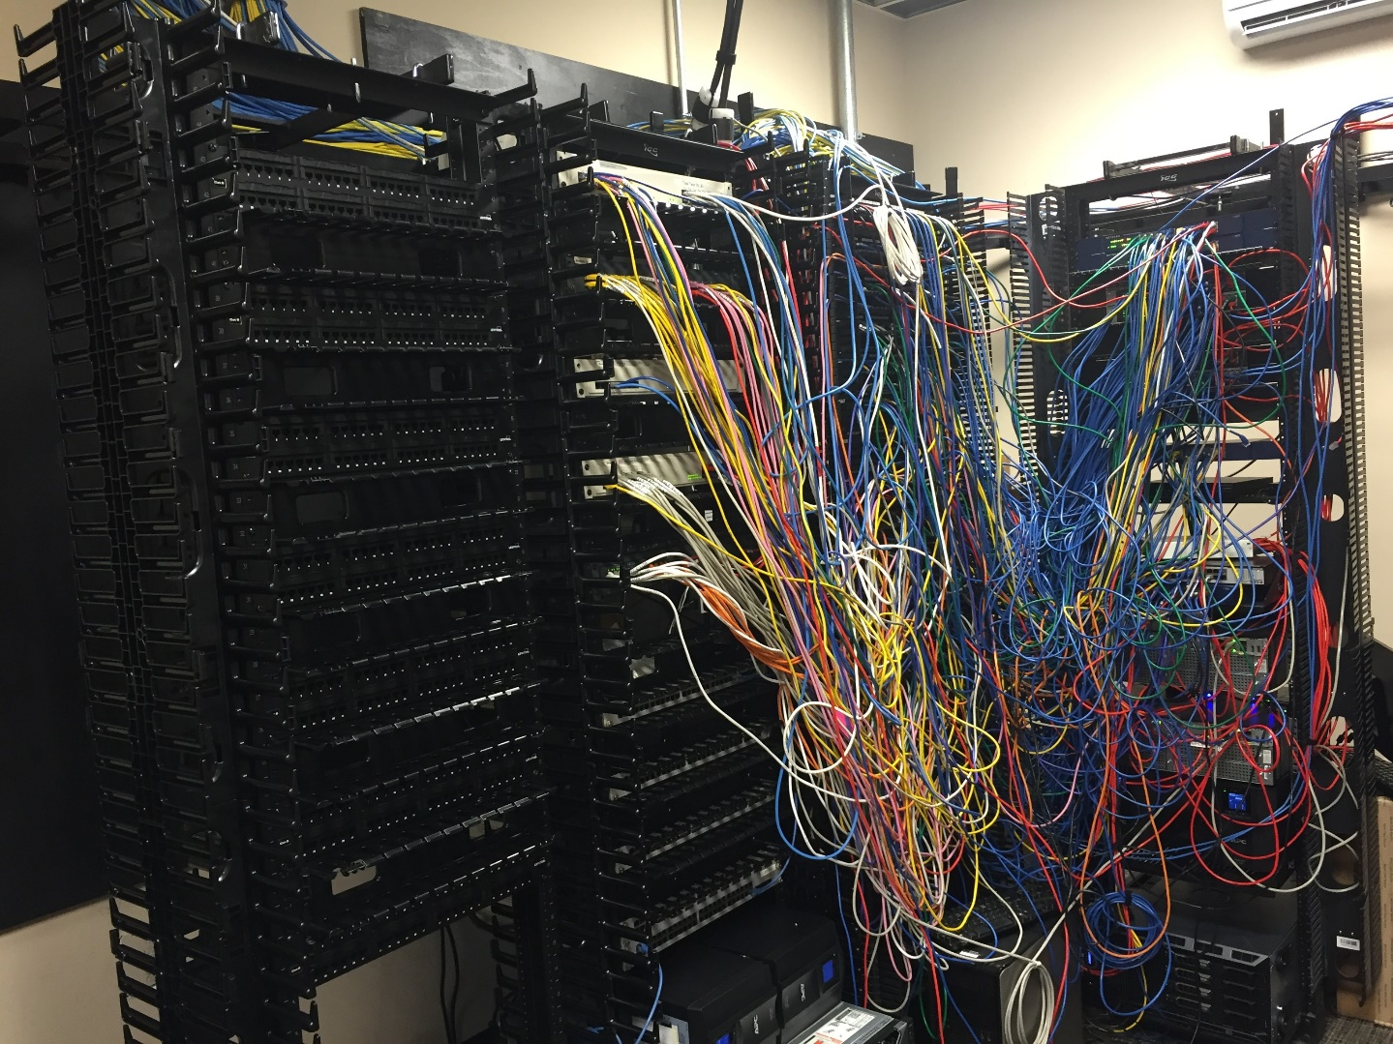
Information Technology

Slide 4

Operational Technology
Source: https://commons.wikimedia.org/wiki/File:Transfer_Pump_Station.jpg
Notes:
UNCLASSIFIED
https://commons.wikimedia.org/wiki/File:Transfer_Pump_Station.jpg
This is what OT systems look like
Instead of an antistatic lab coat, you wear a hard-hat and steel-toed shoes. ICS must function in environments that are electrically noisy, dirty, at temperature extremes, etc.
Operational technology (OT) is hardware and software that detects or causes a change through the direct monitoring and/or control of physical devices, processes and events in the enterprise.
Source: https://en.wikipedia.org/wiki/Operational_Technology
OT's modernization through IT integration brings with it the required consideration of security. Many operational technology systems were never designed for remote accessibility and, as a result, the risks of connectivity were not considered. Such systems may not be regularly updated. The vulnerabilities of OT systems can leave organizations and critical infrastructure at risk of industrial espionage and sabotage.
What is it OT convergence?
IT/OT convergence is the integration of information technology (IT) systems used for data-centric computing with operational technology (OT) systems used to monitor events, processes and devices and make adjustments in enterprise and industrial operations.
Operational Technology is utilized in many sectors and environments, such as:
Oil & Gas
Power and Utilities
Chemicals manufacturing
Water treatment
Waste management
Transportation
Scientific experimentation
Historically, ICS were physically isolated or air-gapped from the outside world. Now systems are linked into the corporate WAN and Internet to allow process monitoring and maintenance for off-site groups.
Control engineers, technicians, operators typically are not skilled in cyber-security. Conversely, IT professionals are not skilled in process control.
– They have different, and sometimes conflicting, goals and management in the corporate structure.
It is difficult to make a business case for cyber-security, though this is improving. The perception is no attacks mean no problems.
Source: https://surveillance-security-camera.blogspot.com/2017/02/detecting-plc-malware-in-industrial.html
UNCLASSIFIED

Slide 5
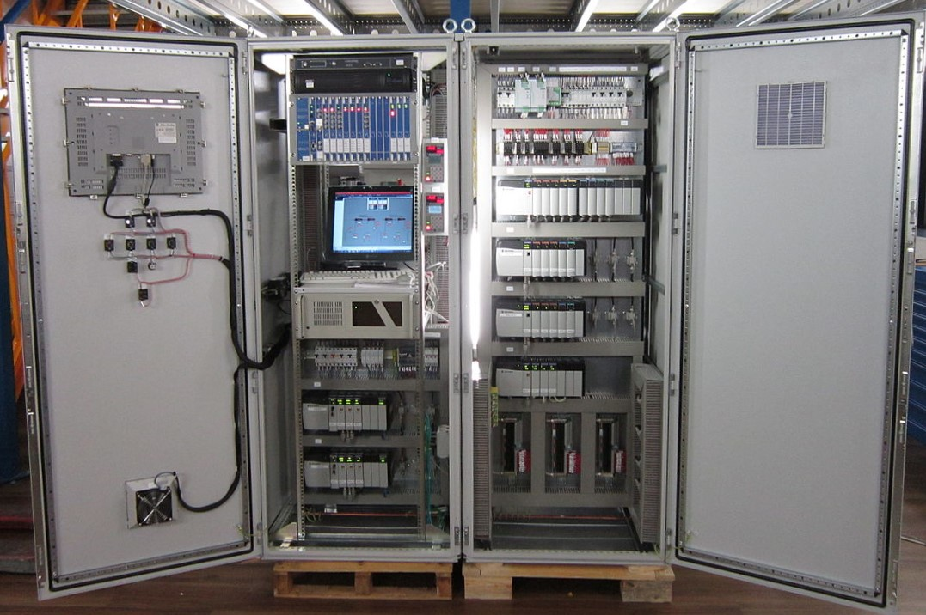
Operational Technology
Notes:
https://www.reeng.com.au/products/control-systems/

Slide 6
What is CI?
Chemical
Commercial Facilities
Communications
Crit. Manufacturing
Dams
Defense Industrial
Emergency Services
Energy
Financial Services
Food & Agriculture
Govt. Facilities
Healthcare
Information Tech
Nuclear
Transportation
Water & Wastewater
Public or private?
Source: dhs.gov
Notes:
UNCLASSIFIED
Informal estimate – sciencedirect – 75-80% is privately owned
SOURCES: https://ics-cert.us-cert.gov/Standards-and-References
NIST 800-82, R2
Guide to Industrial Control System Security
http://nvlpubs.nist.gov/nistpubs/SpecialPublications/NIST.SP.800-82r2.pdf
This document provides guidance on how to secure Industrial Control Systems (ICS), including Supervisory Control and Data Acquisition (SCADA) systems, Distributed Control Systems (DCS), and other control system configurations such as Programmable Logic Controllers (PLC), while addressing their unique performance, reliability, and safety requirements. The document provides an overview of ICS and typical system topologies, identifies typical threats and vulnerabilities to these systems, and provides recommended security countermeasures to mitigate the associated risks.
It includes new guidance on how to tailor traditional IT security controls to accommodate unique ICS performance, reliability and safety requirements, as well as updates to sections on threats and vulnerabilities, risk management, recommended practices, security architectures and security capabilities and tools.
NIST 800-53, R4 (Security and Privacy Controls for Federal Information Systems and Organizations)
http://nvlpubs.nist.gov/nistpubs/SpecialPublications/NIST.SP.800-53r4.pdf
NIST 800-53 is a publication that recommends security controls for federal information systems and organizations and documents security controls for all federal information systems, except those designed for national security.
NIST 800-53 is published by the National Institute of Standards and Technology, which creates and promotes the standards used by federal agencies to implement the Federal Information Security Management Act (FISMA) and manage other programs designed to protect information and promote information security. Agencies are expected to meet NIST guidelines and standards within one year of publication.
NIST 800-53 is also known as NIST Special Publication 800-53.
https://csrc.nist.gov/csrc/media/publications/sp/800-53/rev-5/draft/documents/sp800-53r5-draft.pdf
IEC 62443-3-3
Security for industrial process measurement and control – network and system security
https://webstore.iec.ch/preview/info_iecpas62443-3%7Bed1.0%7Den.pdf
It establishes a framework for securing information and communication technology aspects of industrial process measurement and control systems including its networks and devices on those networks, during the operational phase of the plant's life cycle. It provides guidance on a plant's operational security requirements and is primarily intended for automation system owners/operators (responsible for ICS operation).
FIPS 140-2
https://csrc.nist.gov/publications/fips/fips140-2/fips1402.pdf
The Federal Information Processing Standard (FIPS) Publication 140-2, (FIPS PUB 140-2), is a U.S. government computer security standard used to approve cryptographic modules. The title is Security Requirements for Cryptographic Modules.
ISO/IEC 27001
https://www.iso.org/isoiec-27001-information-security.html
The ISO/IEC 27000 family of standards helps organizations keep information assets secure.
https://www.iso.org/standard/54533.html
www.iso27001security.com/html/27002.html
ISO/IEC 27002:2013 Information technology — Security techniques — Code of practice for information security controls (second edition)
NERC CIP 003
www.nerc.com/pa/Stand/Reliability%20Standards/CIP-003-6.pdf
http://www.nerc.com/pa/Stand/Pages/CIPStandards.aspx
DO-178B,
https://en.wikipedia.org/wiki/DO-178B
https://www.rtca.org/content/do-178c-training-0
Software Considerations in Airborne Systems and Equipment Certification is a guideline dealing with the safety of safety-critical software used in certain airborne systems. Although technically a guideline, it is (or was) a de facto standard for developing avionics software systems.
American Petroleum Institute (API) 1164
Pipeline SCADA Security
https://energy.gov/sites/prod/files/Summary%20of%20CS%20Standards%20Activities%20in%20the%20Energy%20Sector.pdf
http://mycommittees.api.org/standards/pipeline/Shared%20Documents/API%201164%203rd%20Edition/Std1164_SCADASecurity_ballotdraft_3Ed_20161028.pdf
US DHS Chemical Facility Anti-Terrorism Standards (CFATS)
https://www.dhs.gov/chemical-facility-anti-terrorism-standards
Nuclear Energy Institute (NEI)
NEI 08-09, Revision 6, “Cyber Security Plan for Nuclear Power Reactors,” April 2010
https://www.nrc.gov/docs/ML1015/ML101550061.pdf
The Federal Information Security Management Act (FISMA) is United States legislation that defines a comprehensive framework to protect government information, operations and assets against natural or man-made threats. FISMA was signed into law part of the Electronic Government Act of 2002.
https://www.dhs.gov/fisma
Industrial Internet Consortium (IIC)
www.iiconsortium.org/
Industrial Internet Consortium (IIC) Security Framework
www.iiconsortium.org/IISF.htm
To that end, IIC members have developed a common security framework and an approach to assess cybersecurity in Industrial Internet of Things systems.
INDUSTRIE 4.0 is the name given to the German strategic initiative to ... 2020, the “INDUSTRIE 4.0”
https://industrie4.0.gtai.de/
UNCLASSIFIED

Slide 7
Military Control Systems
Building Automation – HVAC, access control
Power – distribution, backup generation, conservation
Water – treatment and waste
Security – perimeter defenses, cameras
Transportation – traffic lights, street lights
Emergency Services – police, fire, EMS
Flight Line – lights, communications
Weapon Systems
Fueling

Slide 8
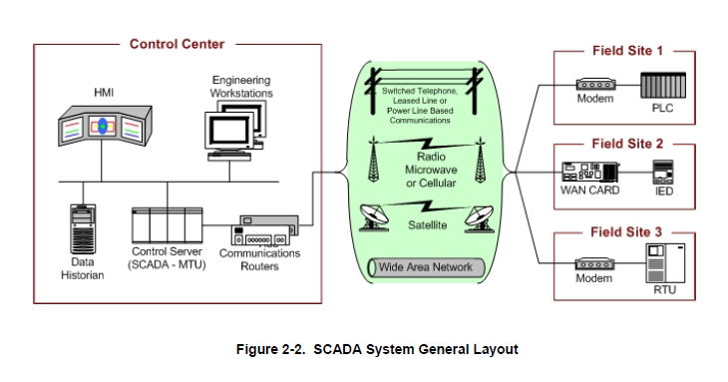
Industrial Control Systems
Source: NIST Special Publication 800-82 r2, Guide to Industrial Control Systems (ICS) Security.
Notes:
UNCLASSIFIED
Source: http://nvlpubs.nist.gov/nistpubs/SpecialPublications/NIST.SP.800-82r2.pdf
https://en.wikipedia.org/wiki/Industrial_control_system
Industrial control system (ICS) is a general term that encompasses several types of control systems and associated instrumentation used in industrial production technology, including supervisory control and data acquisition (SCADA) systems, distributed control systems (DCS), and other smaller control system configurations such as programmable logic controllers (PLC) often found in the industrial sectors and critical infrastructures.^{[1]}
Industrial control systems are typically used in industries such as electrical, water, oil, gas and data.
Based on data received from remote stations, automated or operator-driven supervisory commands can be pushed to remote station control devices, which are often referred to as field devices. Field devices control local operations such as opening and closing valves and breakers, collecting data from sensor systems, and monitoring the local environment for alarm conditions.
PLC, DPU, SCADA, and DCS all fall into the category of ICS. The architecture of a PLC is theoretically similar to a DPU, so we will look at PLCs more closely as a model.
ICS – Systems that control industrial processes
ICS touch every aspect of our lives
DCS – Distributed control system
SCADA – Supervisory control and data acquisition
BAS – building automation systems
Water treatment
Power generation and distribution
Example of an Industrial Devices Controlling System Using Bluetooth
http://amvitech.com/project-industrial-devices-controlling-system-using-Bluetooth
Other components that round out a complete ICS are: HMI, ENG (engineering workstation), HIST (data historian or process data archive)
The operator operates the process through the HMI workstation. The engineer maintains the ICS through an engineering workstation. A historian workstation collects process data in an archive for future analysis and troubleshooting.
A PLC is often used to control relatively small processes, such as one leg of an assembly line or other process with a few components. From a few up to a few hundred Input/Output (I/O) points each.
Supervisory Control And Data Acquisition (SCADA) refers to multiple PLCs networked together for control of multiple small processes, often including small processes at remote sites.
A Distributed Control System (DCS) is used for larger processes, such as a power generation process or other centralized plantwide control, using Distributed Processing Units (DPU) on a dedicated network with each DPU handling thousands of points of I/O.
UNCLASSIFIED

Slide 9
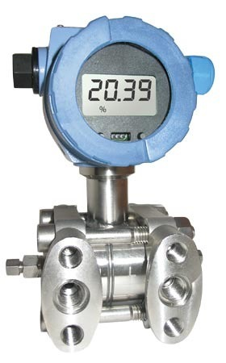
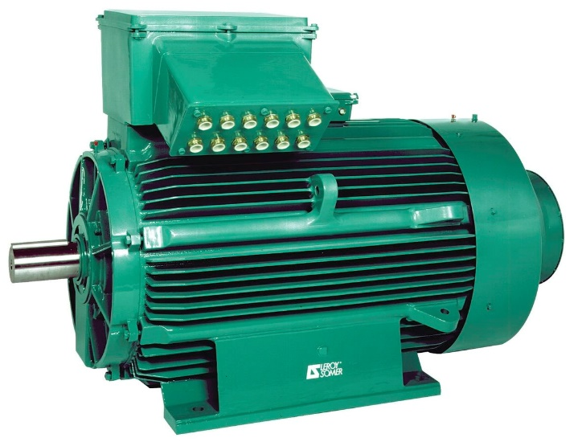
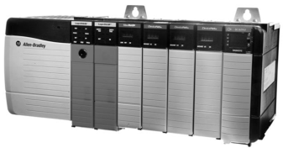
Field Sites
Digital:
0 – 24 VDC
0 – 110 VAC
Analog:
0 – 10 VDC
0 – 20 mA
4 – 20 mA

Slide 10
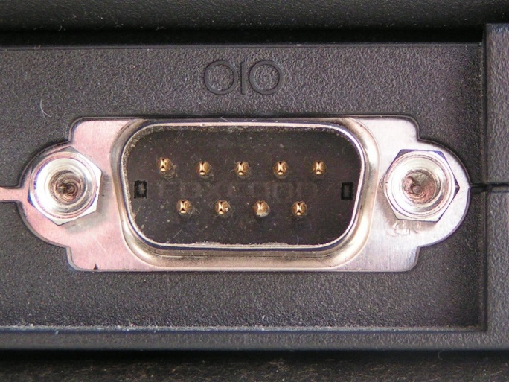
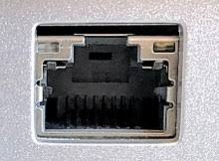
3rd Generation of ICS
3rd Generation (Networked): mid 1990’s to present
Use of IP for communications
Allows remote programming and logic
Reach back to enterprise network via Internet
1960
1970
1980
1990
2000
2010
3rd Generation
Notes:
UNCLASSIFIED
Third generation: "networked"
Similar to a distributed architecture, any complex SCADA can be reduced to simplest components and connected through communication protocols. In the case of a networked design, the system may be spread across more than one LAN network called a process control network (PCN) and separated geographically. Several distributed architecture SCADAs running in parallel, with a single supervisor and historian, could be considered a network architecture. This allows for a more cost effective solution in very large scale systems.
– As we said earlier, these are being replaced with Ethernet-based protocols, such as Siemens SIMATIC NET, Allen Bradley Ethernet/IP, to allow COTS Ethernet solutions. The idea being that Ethernet is fast enough to allow every node to communicate whenever needed. Still, there is a significant penetration of these network protocols and they are still deployed in some instances.
Fourth generation: "Internet of things"
With the commercial availability of cloud computing, SCADA systems have increasingly adopted Internet of things technology to significantly reduce infrastructure costs and increase ease of maintenance and integration. As a result, SCADA systems can now report state in near real-time and use the horizontal scale available in cloud environments to implement more complex control algorithms than are practically feasible to implement on traditional programmable logic controllers.^{[12][13]}Further, the use of open network protocols such as TLS inherent in the Internet of things technology, provides a more readily comprehensible and manageable security boundary than the heterogeneous mix of proprietary network protocols typical of many decentralized SCADA implementations. One such example of this technology is an innovative approach to rainwater harvesting through the implementation of real time controls (RTC)^{[citation needed]}.
This decentralization of data also requires a different approach to SCADA than traditional PLC based programs. When a SCADA system is used locally, the preferred methodology involves binding the graphics on the user interface to the data stored in specific PLC memory addresses. However, when the data comes from a disparate mix of sensors, controllers and databases (which may be local or at varied connected locations), the typical 1 to 1 mapping becomes problematic. A solution to this is data modeling, a concept derived from object oriented programming.^{[14]}
In a data model, a virtual representation of each device is constructed in the SCADA software. These virtual representations (“models”) can contain not just the address mapping of the device represented, but also any other pertinent information (web based info, database entries, media files, etc.) that may be used by other facets of the SCADA/IoT implementation. As the increased complexity of the Internet of things renders traditional SCADA increasingly “house-bound,” and as communication protocols evolve to favor platform-independent, service-oriented architecture (such as OPC UA),^{[15]} it is likely that more SCADA software developers will implement some form of data modeling.
Slammer worm crashed Ohio nuke plant network Kevin Poulsen, SecurityFocus 2003-08-19
Source: http://www.securityfocus.com/news/6767
The Slammer worm penetrated a private computer network at Ohio's Davis-Besse nuclear power plant in January and disabled a safety monitoring system for nearly five hours, despite a belief by plant personnel that the network was protected by a firewall, SecurityFocus has learned.
UNCLASSIFIED

Slide 11
IIoT
IP/TCP
Ethernet
Wireless

Slide 12
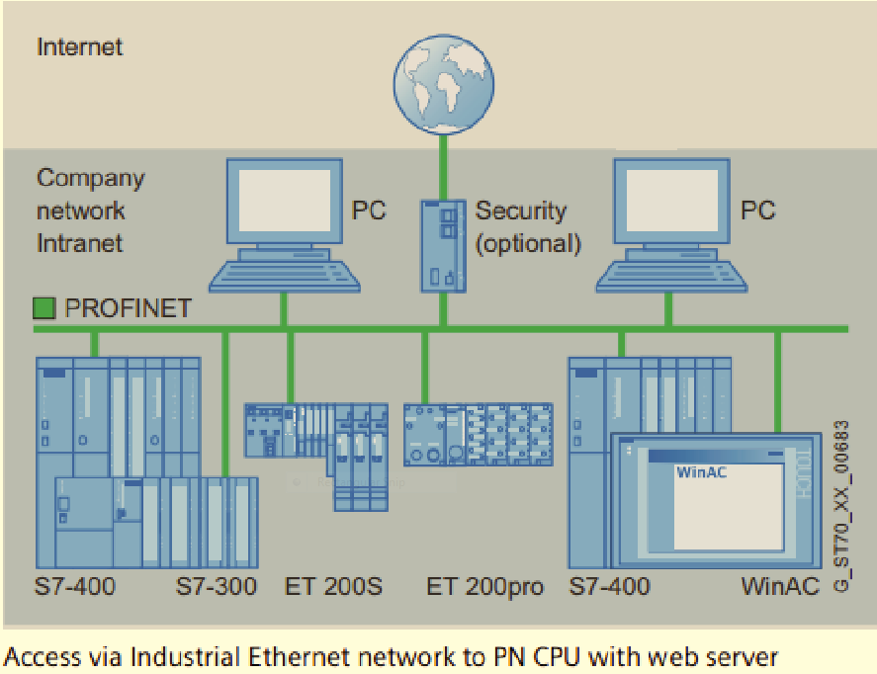
The Problem
???
Notes:
Image taken from SIEMENS network setup manual
Security in ICS:
Best case: necessity for limiting liability
Most cases: optional afterthought
Worst case: unnecessary nuisance
Utilities do not have the budget or bandwidth to secure their systems

Slide 13

Attacking EMCS
Source: Max Cornelisse
Notes:
UNCLASSIFIED
Disclaimer: Don’t know for sure whether the video is of an actual event or not, so determine yourself if it’s true or false. But it is within the realm of possible, right?
Max Cornelisse
Source: https://www.youtube.com/watch?v=QvUXkchVTjc
Other source material on Max:
https://vimeo.com/channels/maxthehacker/page:1
https://gbatemp.net/threads/max-cornelisse-true-or-fake.216462/
https://ucnim.wordpress.com/2009/01/14/max-cornelisse-amazing-computer-hacker/
UNCLASSIFIED

Slide 14
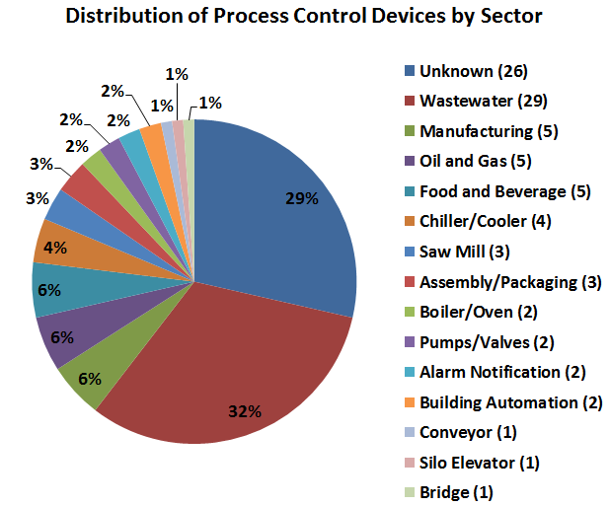
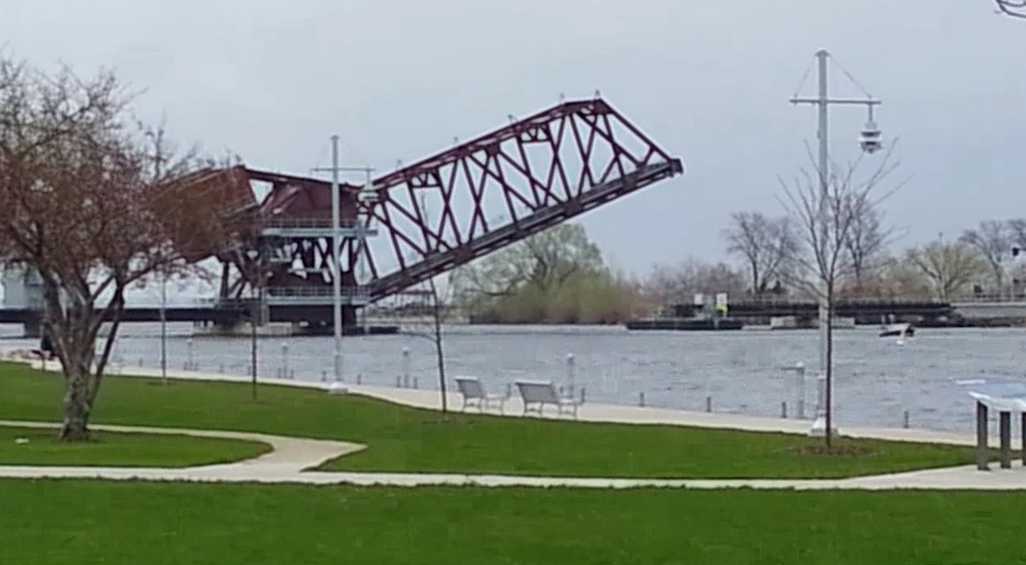
Internet Facing Devices
Source: Williams, P. M. (2014). Distinguishing internet-facing ICS devices using plc programming information (No. AFIT-ENG-T-14-J-41). AFIT, Graduate School of Engineering and Management.
Notes:
UNCLASSIFIED
Source: http://www.dtic.mil/cgi-bin/GetTRDoc?Location=U2&doc=GetTRDoc.pdf&AD=ADA602989
Abstract:
“The Shodan search engine reveals Industrial Control System (ICS) devices around the globe are directly connected to the Internet. After Shodan’s inception in 2009, multiple news reports have focused on the increased threat to infrastructure posed by Shodan. While no attacks to date have been directly attributed to Shodan searches, its existence provides an anonymous reconnaissance platform that facilitates ICS targeting for those actors with both a desire and capability to carry out attacks. Recent research has demonstrated that simple search queries return thousands of ICS devices indexed by Shodan, and the number of newly indexed ICS devices is growing. This research discusses the method used to distinguish the Internet-facing ICS devices indexed by the Shodan search engine. PLC code
is obtained by sending specifically crafted CIP request messages to the devices, capitalizing on the fact that authentication is not built in to the CIP application layer protocol. This data allows categorization of Internet-facing devices by comparing PLC code attributes. The results of this research show PLC code can be collected from Internet-facing ICS devices with no significant impact to task execution times. Also, this research demonstrates a method to distinguish Internet-facing ICS devices by function and by Critical Infrastructure sector. This capability develops an understanding of the function and purpose of ICS devices that are being connected to the Internet.”
Source: https://ics-community.sans.org/t/y7tjrk/ddos-is-so-yesterday-pdos-is-the-new-rage
Now there is a new attack being called "BrickerBot" that uses similar methods and targets similar devices but instead of the DDoS, it creates a permanent denial of service or PDoS. The malware uses internet accessible Telnet and SSH services to gain device access and then takes steps to disrupt its internet connectivity and permanently corrupt the device firmware preventing basic functionality.
Radware first published a detailed report last week and the ICS-CERT issued ICS-ALERT-17-102-01 yesterday warning of the attacks "which exploit hard-coded passwords in IoT devices in order to cause a permanent denial of service (PDoS)." ICS-CERT is working to identify vendors of affected IoT devices in order to collect product-specific mitigations and compensating controls.
Check out the full Radware report at: https://security.radware.com/ddos-threats-attacks/brickerbot-pdos-permanent-denial-of-service/
Maroochy water breach in Australia:
http://www.ifip.org/wcc2008/site/IFIPSampleChapter.pdf
https://www.theregister.co.uk/2001/10/31/hacker_jailed_for_revenge_sewage/
http://www.computerworld.com/article/2561484/security0/utility-hack-led-to-security-overhaul.html
UNCLASSIFIED

Slide 15

Attacking a Bridge
Source: Max Cornelisse
Notes:
UNCLASSIFIED
Max Cornelisse
Source: https://www.youtube.com/watch?v=Oz3-NethUNY
Other source material on Max:
https://vimeo.com/channels/maxthehacker/page:1
https://gbatemp.net/threads/max-cornelisse-true-or-fake.216462/
https://ucnim.wordpress.com/2009/01/14/max-cornelisse-amazing-computer-hacker/
UNCLASSIFIED

Slide 16
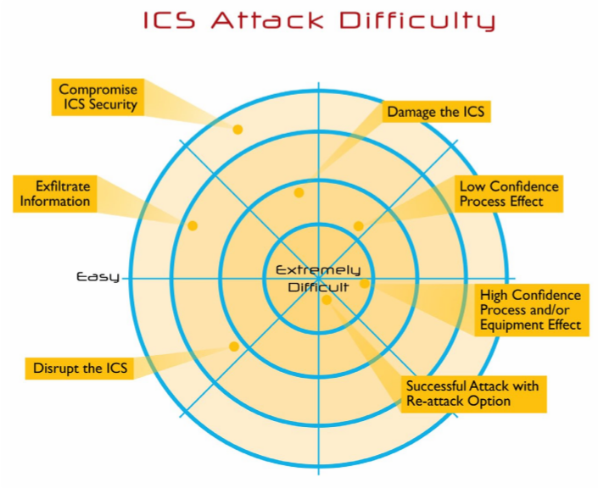
ICS Cyber Kill Chain
https://www.sans.org/reading-room/whitepapers/ICS/industrial-control-system-cyber-kill-chain-36297

Slide 17
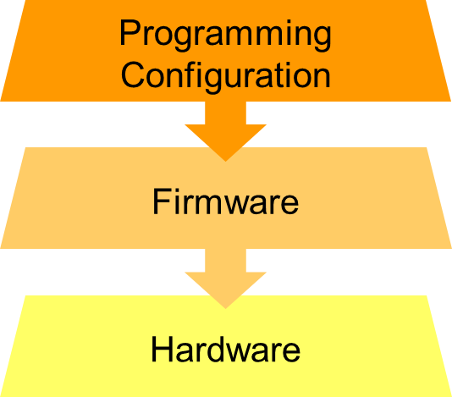
Targets
Source: NIST Special Publication 800-82 r2, Guide to Industrial Control Systems (ICS) Security.
Notes:
UNCLASSIFIED
Source: http://nvlpubs.nist.gov/nistpubs/SpecialPublications/NIST.SP.800-82r2.pdf
https://en.wikipedia.org/wiki/Industrial_control_system
Industrial control system (ICS) is a general term that encompasses several types of control systems and associated instrumentation used in industrial production technology, including supervisory control and data acquisition (SCADA) systems, distributed control systems (DCS), and other smaller control system configurations such as programmable logic controllers (PLC) often found in the industrial sectors and critical infrastructures.^{[1]}
Industrial control systems are typically used in industries such as electrical, water, oil, gas and data.
Based on data received from remote stations, automated or operator-driven supervisory commands can be pushed to remote station control devices, which are often referred to as field devices. Field devices control local operations such as opening and closing valves and breakers, collecting data from sensor systems, and monitoring the local environment for alarm conditions.
PLC, DPU, SCADA, and DCS all fall into the category of ICS. The architecture of a PLC is theoretically similar to a DPU, so we will look at PLCs more closely as a model.
ICS – Systems that control industrial processes
ICS touch every aspect of our lives
DCS – Distributed control system
SCADA – Supervisory control and data acquisition
BAS – building automation systems
Water treatment
Power generation and distribution
Example of an Industrial Devices Controlling System Using Bluetooth
http://amvitech.com/project-industrial-devices-controlling-system-using-Bluetooth
Other components that round out a complete ICS are: HMI, ENG (engineering workstation), HIST (data historian or process data archive)
The operator operates the process through the HMI workstation. The engineer maintains the ICS through an engineering workstation. A historian workstation collects process data in an archive for future analysis and troubleshooting.
A PLC is often used to control relatively small processes, such as one leg of an assembly line or other process with a few components. From a few up to a few hundred Input/Output (I/O) points each.
Supervisory Control And Data Acquisition (SCADA) refers to multiple PLCs networked together for control of multiple small processes, often including small processes at remote sites.
A Distributed Control System (DCS) is used for larger processes, such as a power generation process or other centralized plantwide control, using Distributed Processing Units (DPU) on a dedicated network with each DPU handling thousands of points of I/O.
UNCLASSIFIED

Slide 18
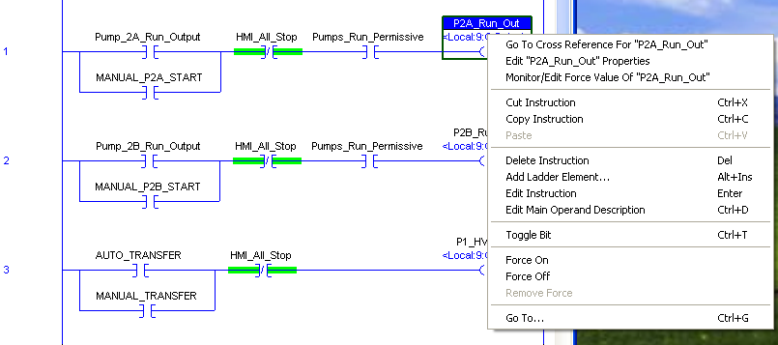
Vendor Tools

Slide 19
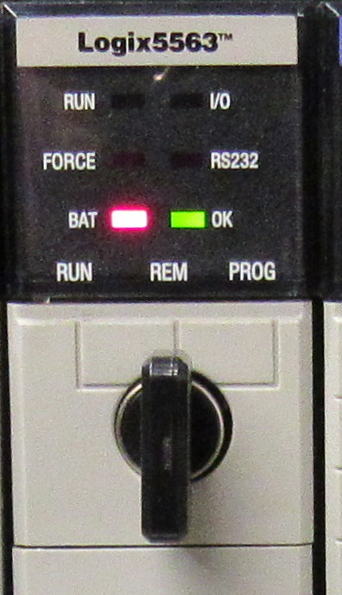
Easy Defense

Slide 20


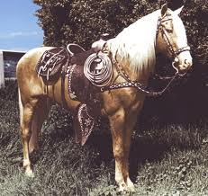
Firmware Implants
Attacks Need:
Deployment
Payloads
Triggers

Slide 21
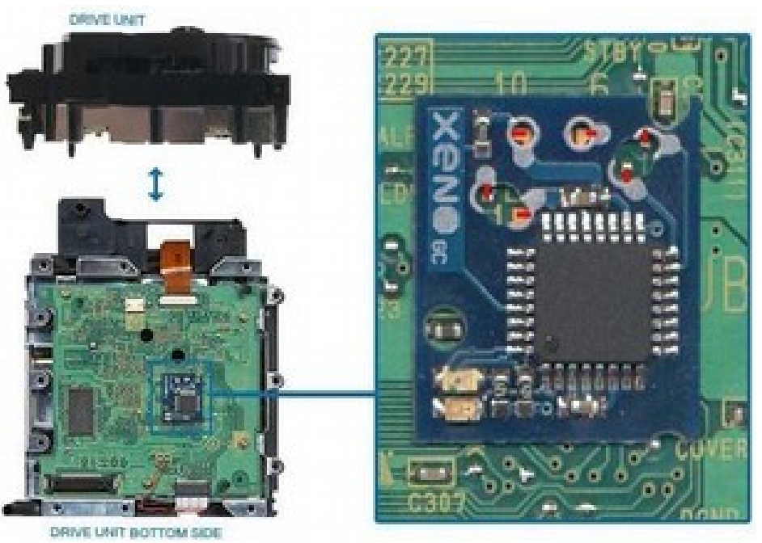
Hardware
Notes:
https://www.blackhat.com/docs/us-16/materials/us-16-FitzPatrick-The-Tao-Of-Hardware-The-Te-Of-Implants-wp.pdf

Slide 22
Defense – NIST Framework
Identify
Protect
Detect
Respond
Recover

Slide 23
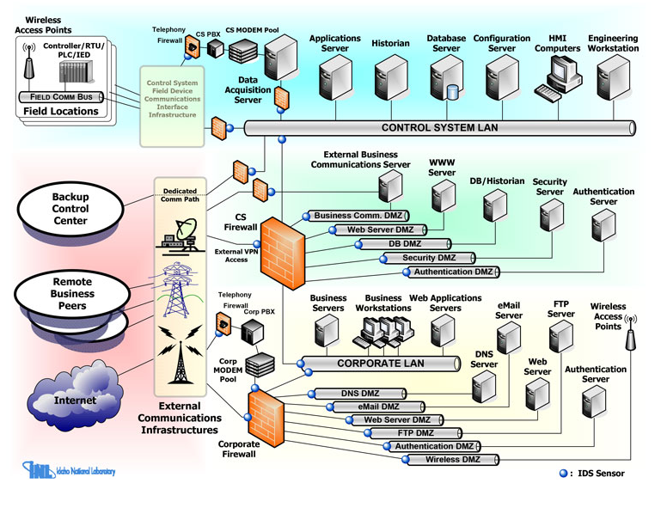
Secure Architecture Design
Source: DHS ICS-CERT (Idaho National Labs)

Slide 24

Questions
stephen.dunlap.ctr@afit.edu
937-255-6565 ext. 3324
Notes:
Image source:
https://pixabay.com/en/question-question-mark-help-2309042/
https://pixabay.com/en/twitter-social-media-icon-social-2430933/

Slide 25
Resources
Stouffer, K., Falco, J., & Scarfone, K. (2011). Guide to industrial control systems (ICS) security. NIST special publication, 800(82), 16-16.
Boyer, S. A. (2009). SCADA: supervisory control and data acquisition. International Society of Automation.
Weiss, J. (2010). Protecting industrial control systems from electronic threats. Momentum Press.
Knapp, E. D., & Langill, J. T. (2014). Industrial Network Security: Securing critical infrastructure networks for smart grid, SCADA, and other Industrial Control Systems. Syngress.
Schmidt, L., O Connell, C., Miyake, H., Shah, A. R., Baron, J. W., Nieboer, G., ... & Taggart, L. (2015). Cyber Practices: What Can the US Air Force Learn from the Commercial Sector?. RAND PROJECT AIR FORCE SANTA MONICA CA.
Shaw, W. T. (2006). Cybersecurity for SCADA systems. Pennwell books.
Bodungen, C., Singer, B., Shbeeb, A., Wilhoit, K., Hilt, S. (2017). Hacking Exposed Industrial Control Systems: ICS and SCADA Security Secrets & Solutions. McGraw-Hill Education.
Notes:
UNCLASSIFIED
Stouffer, K., Falco, J., & Scarfone, K. (2011). Guide to industrial control systems (ICS) security. NIST special publication, 800(82), 16-16.
Boyer, S. A. (2009). SCADA: supervisory control and data acquisition. International Society of Automation.
Weiss, J. (2010). Protecting industrial control systems from electronic threats. Momentum Press.
Knapp, E. D., & Langill, J. T. (2014). Industrial Network Security: Securing critical infrastructure networks for smart grid, SCADA, and other Industrial Control Systems. Syngress.
Schmidt, L., O Connell, C., Miyake, H., Shah, A. R., Baron, J. W., Nieboer, G., ... & Taggart, L. (2015). Cyber Practices: What Can the US Air Force Learn from the Commercial Sector?. RAND PROJECT AIR FORCE SANTA MONICA CA.
Shaw, W. T. (2006). Cybersecurity for SCADA systems. Pennwell books.
Bodungen, C., Singer, B., Shbeeb, A., Wilhoit, K., Hilt, S. (2017). Hacking Exposed Industrial Control Systems: ICS and SCADA Security Secrets & Solutions. McGraw-Hill Education.
UNCLASSIFIED

